Slide 1





Machine Learning (Supervised Learning)

Slide 2

Hello!
I am Eslam Ahmed
I am a software engineer.
You can find me at jeksogsa@gmail.com

Slide 3

Hello!
I am Eman Ehab
I am a ML research engineer.
You can find me at emanehab.ieee@gmail.com

Slide 4
Machine Learning
Supervised Learning
Regression
Simple Linear Regression
Multiple Linear Regression
Polynomial Regression
Evaluating Model Performance
Classification
Logistic Regression
K-Nearest Neighbors (KNN)
Naive Bayes
SVM
Decision Trees
Ensemble Methods
What is Bagging & Boosting
Random Forests
XGBoost
Evaluating Model Performance
Unsupervised Learning
Clustering
KMeans
Hierarchical Clustering
Density Based Clustering - DBSCAN
Association rule mining
Apriori
Dimension Reduction
PCA
LDA
Evaluating Model Performance
Model Selection & Evaluation
Cross Validation
Hyperparameter Tuning
Grid Search
Randomized Search
Recommendation Systems

Slide 5
Machine Learning
Supervised Learning
Regression
Simple Linear Regression
Multiple Linear Regression
Polynomial Regression
Evaluating Model Performance
Classification
Logistic Regression
K-Nearest Neighbors (KNN)
Naive Bayes
SVM
Decision Trees
Ensemble Methods
What is Bagging & Boosting
Random Forests
XGBoost
Evaluating Model Performance
Unsupervised Learning
Clustering
KMeans
Hierarchical Clustering
Density Based Clustering - DBSCAN
Association rule mining
Apriori
Dimension Reduction
PCA
LDA
Evaluating Model Performance
Model Selection & Evaluation
Cross Validation
Hyperparameter Tuning
Grid Search
Randomized Search
Recommendation Systems

Slide 6




Machine Learning
Machine learning involves computers discovering how
they can perform tasks without being explicitly
programmed to do so. It involves computers learning
from data provided so that they carry out certain tasks.

Slide 7
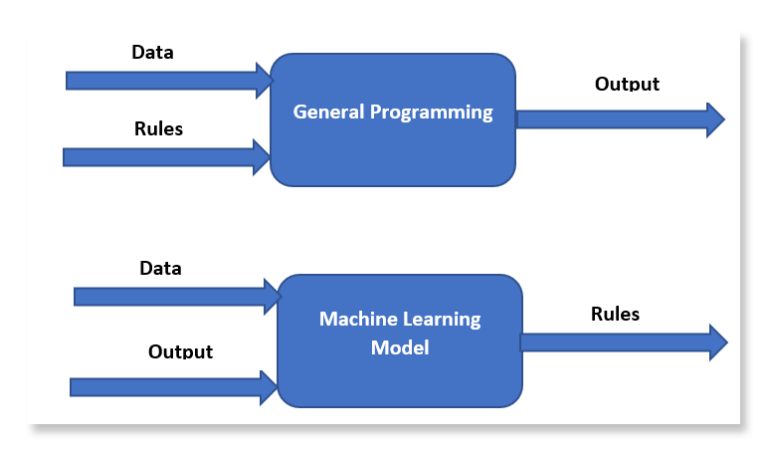

Machine Learning

Slide 8
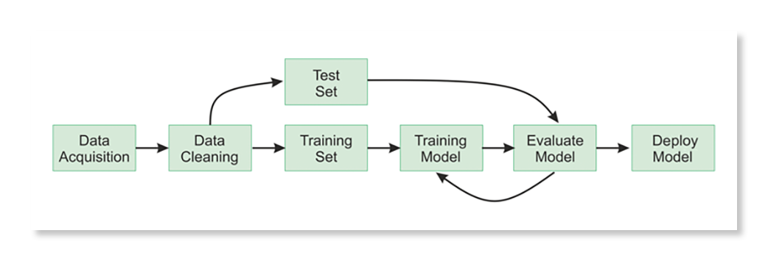
Machine Learning

Slide 9
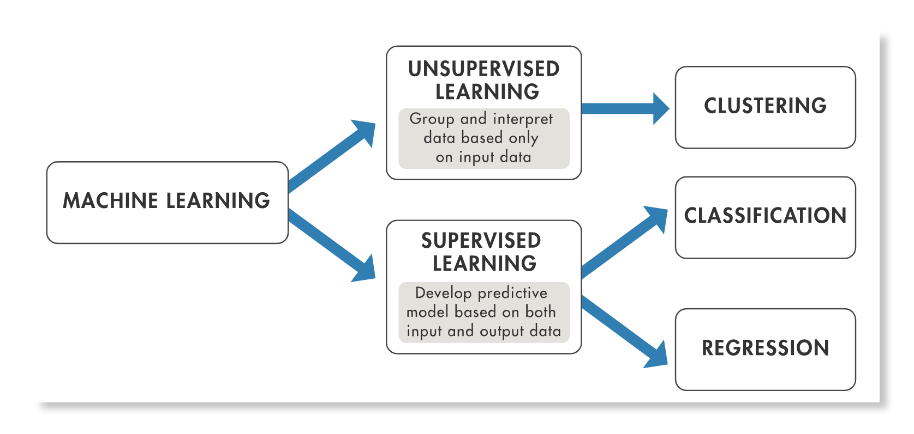
Machine Learning

Slide 10
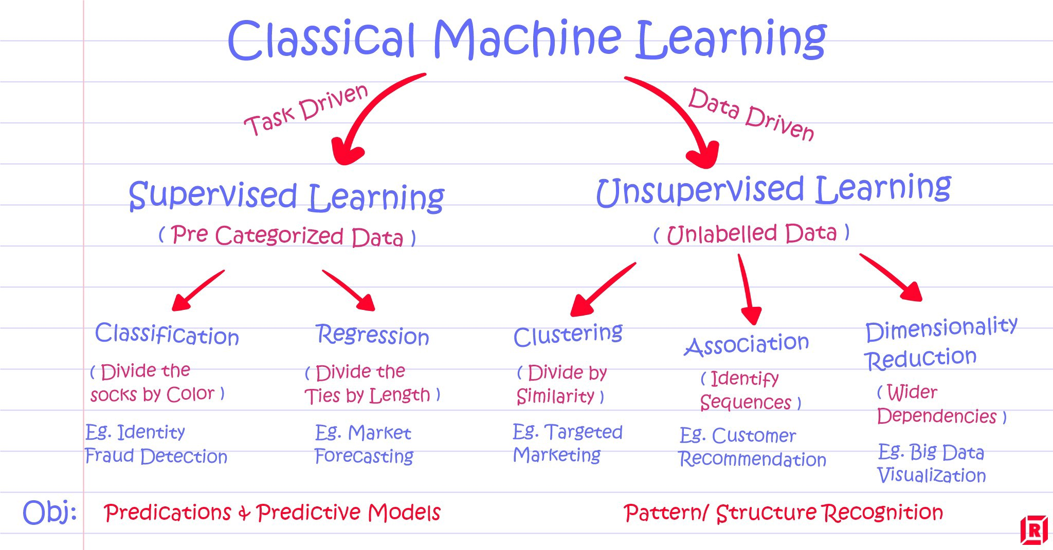
Machine Learning

Slide 11
Machine Learning
Supervised learning : Task Driven (Classification, Regression)
Unsupervised learning : Data Driven (Clustering)
Reinforcement learning :
Close to human learning.
Algorithm learns a policy of how to act in a given environment.
Every action has some impact in the environment, and the environment provides rewards that guides the learning algorithm.

Slide 12
Machine Learning
Supervised Learning
Regression
Simple Linear Regression
Multiple Linear Regression
Polynomial Regression
Evaluating Model Performance
Classification
Logistic Regression
K-Nearest Neighbors (KNN)
Naive Bayes
SVM
Decision Trees
Ensemble Methods
What is Bagging & Boosting
Random Forests
XGBoost
Evaluating Model Performance
Unsupervised Learning
Clustering
KMeans
Hierarchical Clustering
Density Based Clustering - DBSCAN
Association rule mining
Apriori
Dimension Reduction
PCA
LDA
Evaluating Model Performance
Model Selection & Evaluation
Cross Validation
Hyperparameter Tuning
Grid Search
Randomized Search
Recommendation Systems

Slide 13
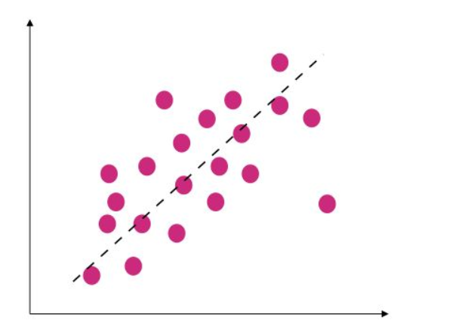
Regression
Regression quantifies the relationship between one or more predictor variable(s) and one outcome variable.
For example,
it can be used to quantify the relative impacts of age, gender, and diet (the predictors) on height (the output or dependent).
House prices based on size, locations,…
Salary prediction based on experience
Stock Market prediction
Weather prediction
…

Slide 14
Machine Learning
Supervised Learning
Regression
Simple Linear Regression
Multiple Linear Regression
Polynomial Regression
Evaluating Model Performance
Classification
Logistic Regression
K-Nearest Neighbors (KNN)
Naive Bayes
SVM
Decision Trees
Ensemble Methods
What is Bagging & Boosting
Random Forests
XGBoost
Evaluating Model Performance
Unsupervised Learning
Clustering
KMeans
Hierarchical Clustering
Density Based Clustering - DBSCAN
Association rule mining
Apriori
Dimension Reduction
PCA
LDA
Evaluating Model Performance
Model Selection & Evaluation
Cross Validation
Hyperparameter Tuning
Grid Search
Randomized Search
Recommendation Systems

Slide 15
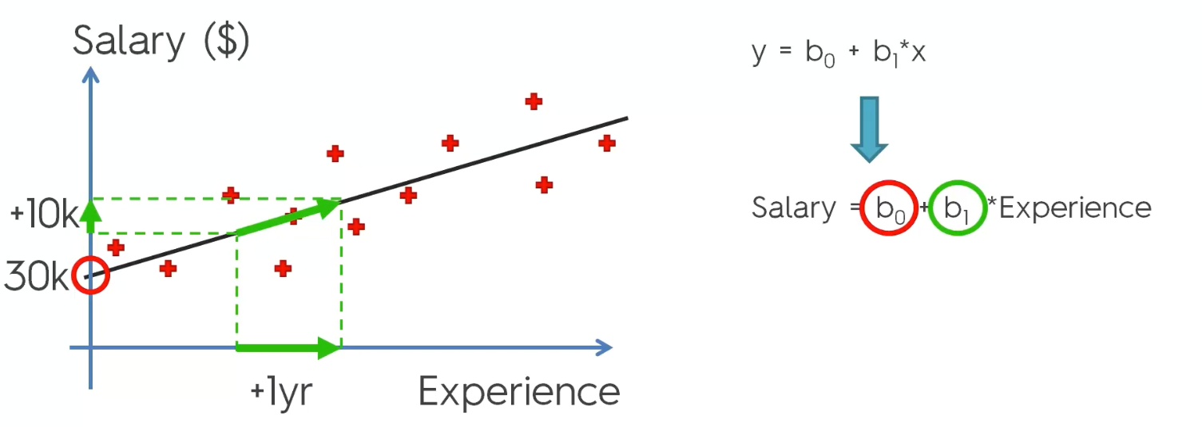
Simple Linear Regression (Equation of a straight line)

Slide 16
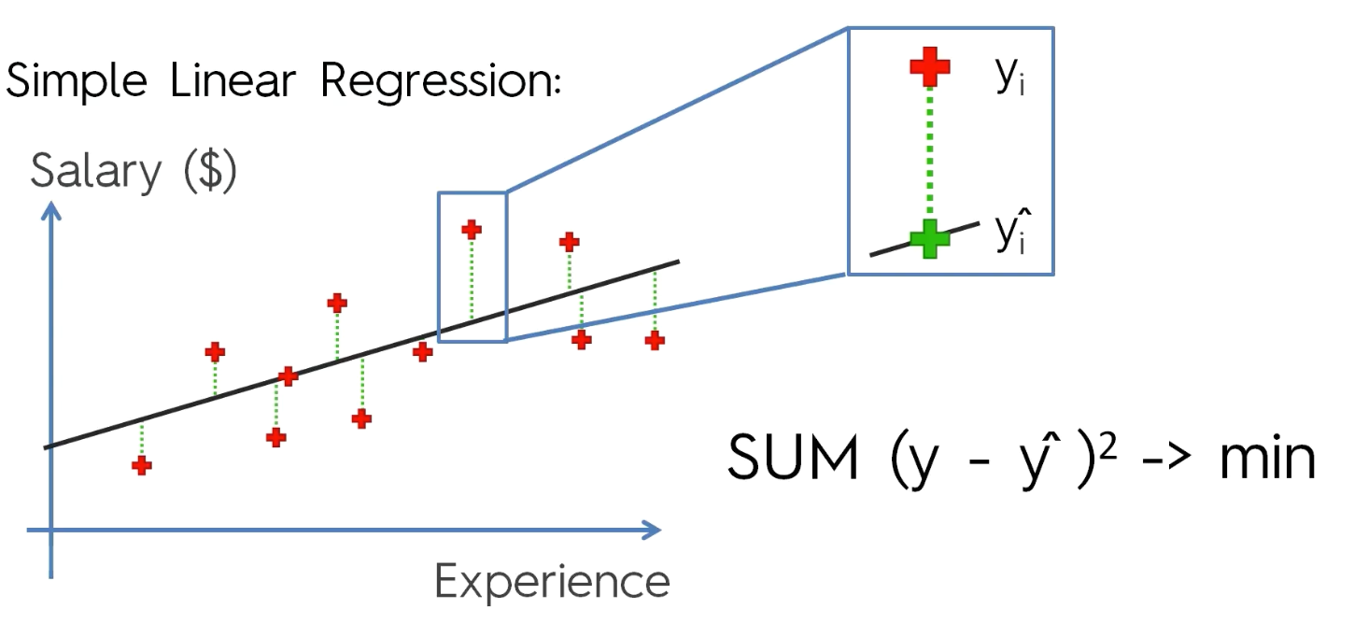
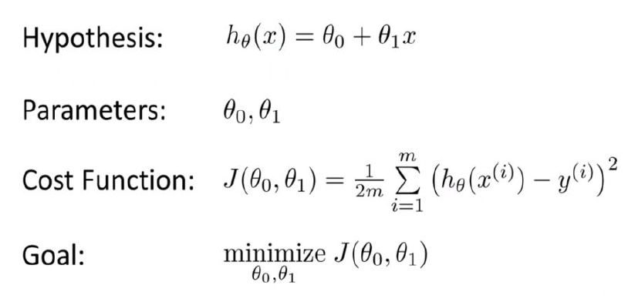
Simple Linear Regression (Calculate Cost Function)

Slide 17
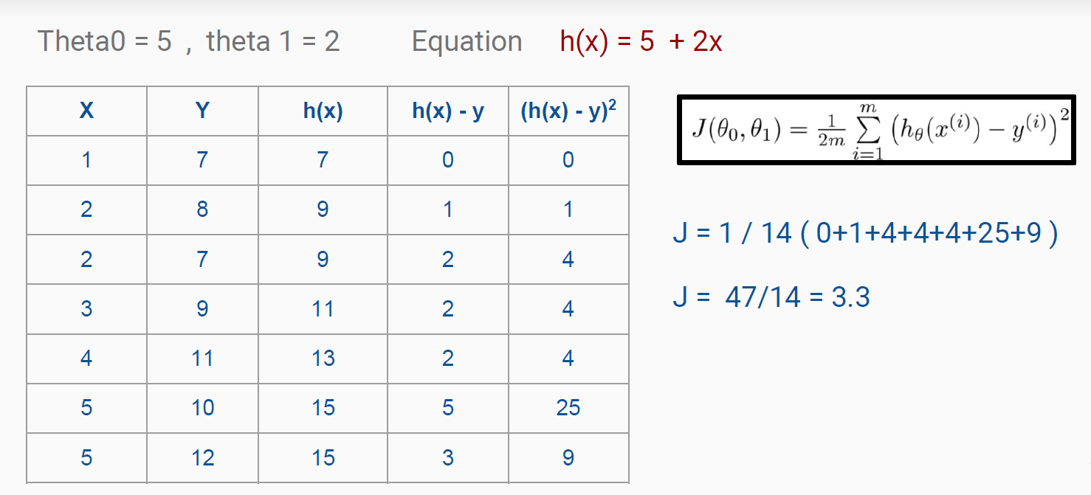
Simple Linear Regression (Example)

Slide 18
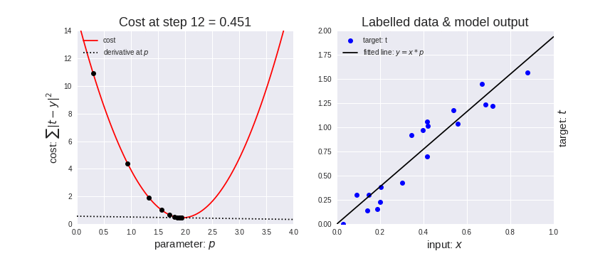
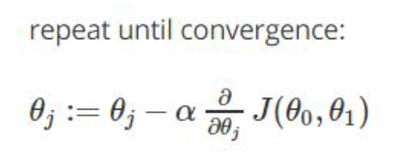
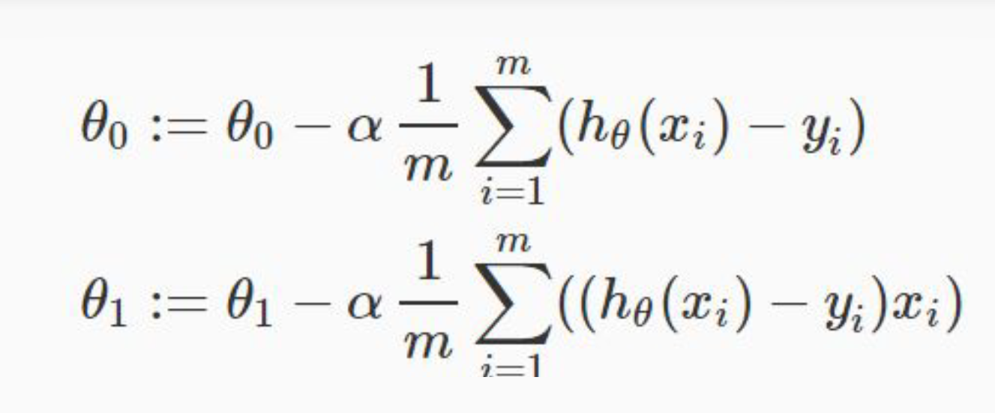
Simple Linear Regression (Minimize cost using Gradient Descent)

Slide 19
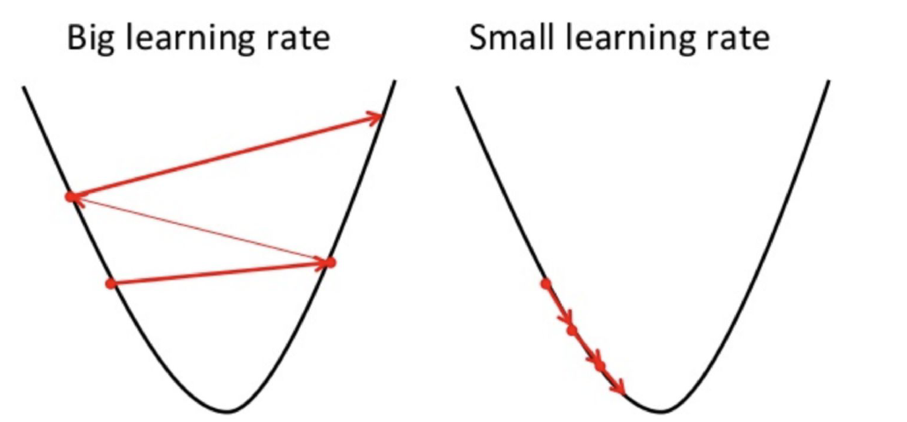
Simple Linear Regression (Alpha constant)

Slide 20
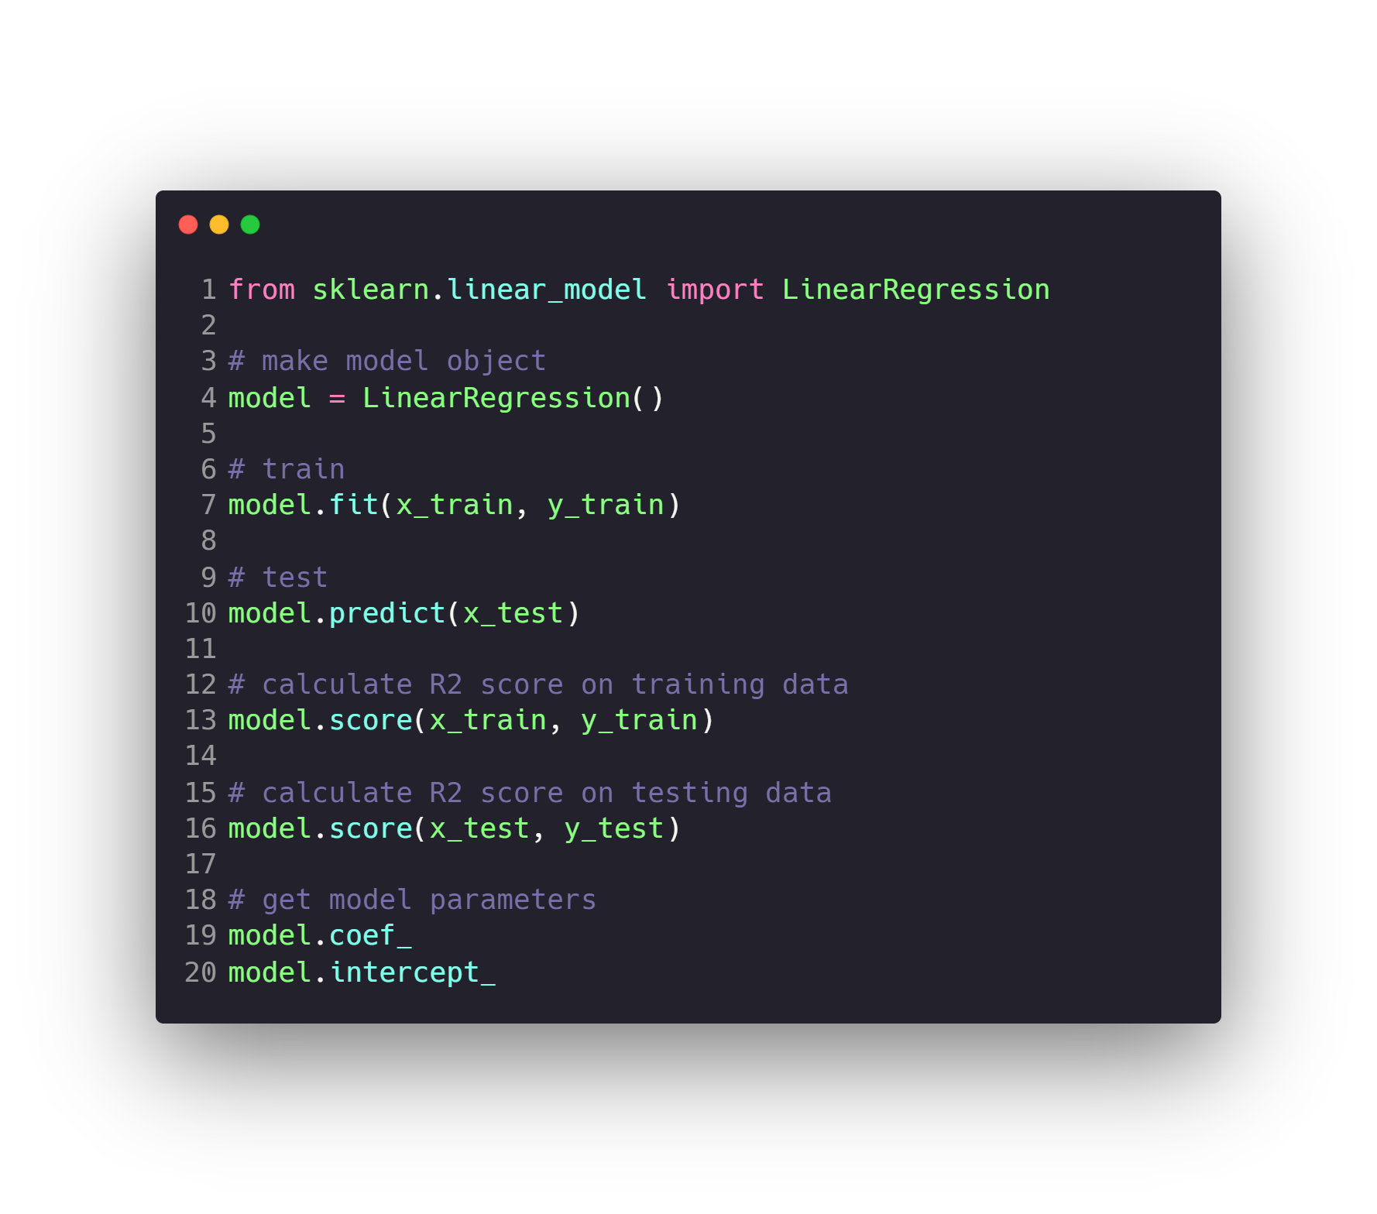
Simple Linear Regression (Code)

Slide 21
Machine Learning
Supervised Learning
Regression
Simple Linear Regression
Multiple Linear Regression
Polynomial Regression
Evaluating Model Performance
Classification
Logistic Regression
K-Nearest Neighbors (KNN)
Naive Bayes
SVM
Decision Trees
Ensemble Methods
What is Bagging & Boosting
Random Forests
XGBoost
Evaluating Model Performance
Unsupervised Learning
Clustering
KMeans
Hierarchical Clustering
Density Based Clustering - DBSCAN
Association rule mining
Apriori
Dimension Reduction
PCA
LDA
Evaluating Model Performance
Model Selection & Evaluation
Cross Validation
Hyperparameter Tuning
Grid Search
Randomized Search
Recommendation Systems

Slide 22
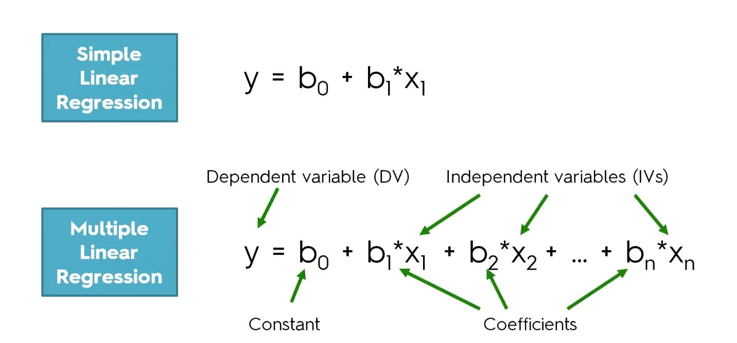
Multiple Linear Regression (Equation)

Slide 23
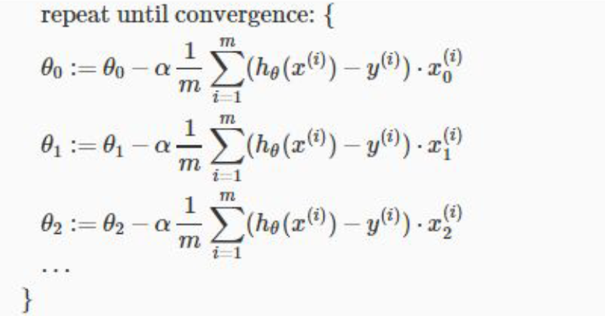
Multiple Linear Regression (Update theta values)

Slide 24
Multiple Linear Regression (Code)

Slide 25
Machine Learning
Supervised Learning
Regression
Simple Linear Regression
Multiple Linear Regression
Polynomial Regression
Evaluating Model Performance
Classification
Logistic Regression
K-Nearest Neighbors (KNN)
Naive Bayes
SVM
Decision Trees
Ensemble Methods
What is Bagging & Boosting
Random Forests
XGBoost
Evaluating Model Performance
Unsupervised Learning
Clustering
KMeans
Hierarchical Clustering
Density Based Clustering - DBSCAN
Association rule mining
Apriori
Dimension Reduction
PCA
LDA
Evaluating Model Performance
Model Selection & Evaluation
Cross Validation
Hyperparameter Tuning
Grid Search
Randomized Search
Recommendation Systems

Slide 26
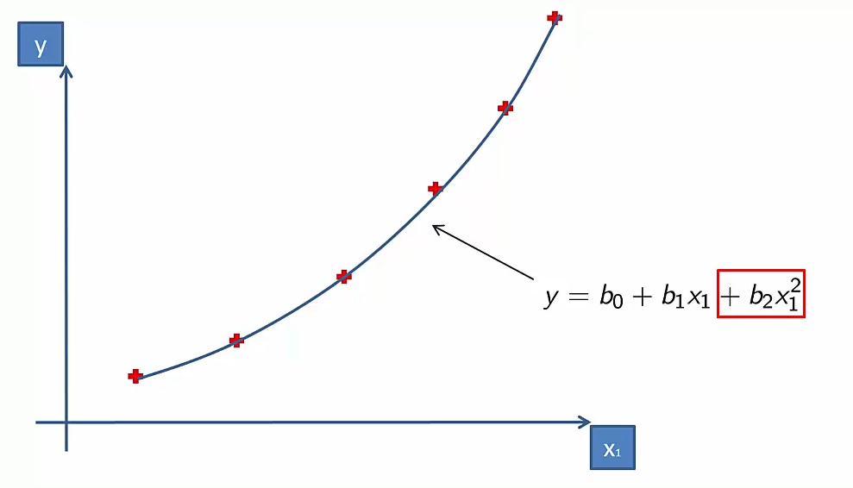
Polynomial Regression (Poly equation)

Slide 27
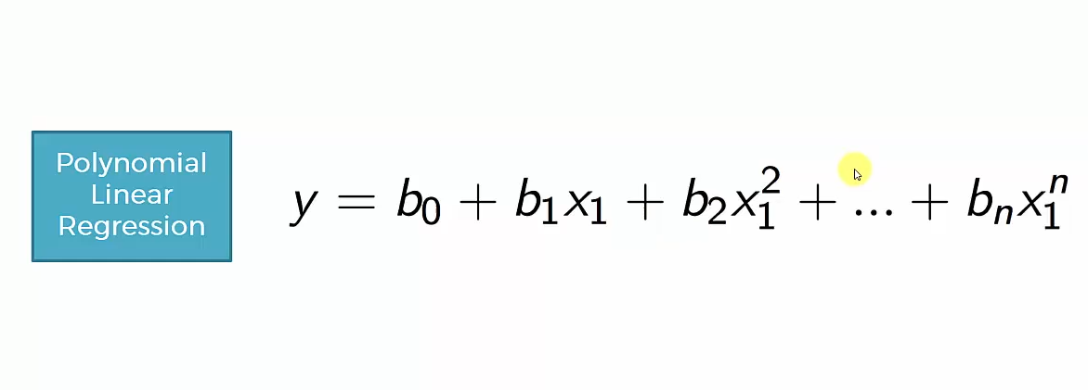
Polynomial Regression (Poly equation)

Slide 28
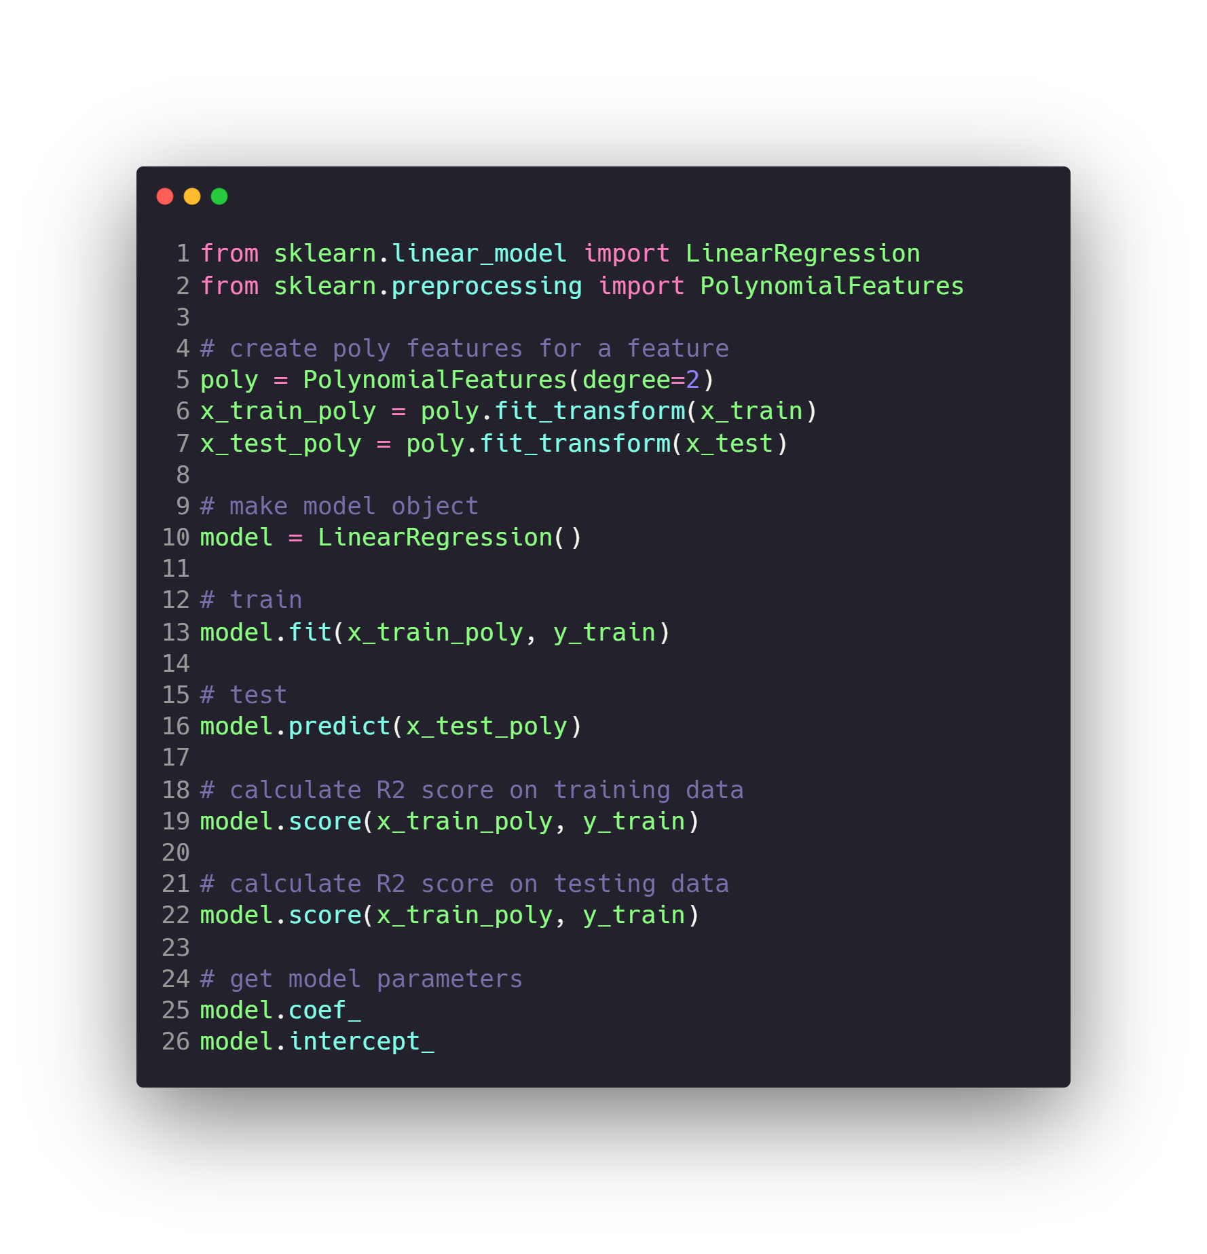
Polynomial Regression (Code)

Slide 29
Machine Learning
Supervised Learning
Regression
Simple Linear Regression
Multiple Linear Regression
Polynomial Regression
Evaluating Model Performance
Classification
Logistic Regression
K-Nearest Neighbors (KNN)
Naive Bayes
SVM
Decision Trees
Ensemble Methods
What is Bagging & Boosting
Random Forests
XGBoost
Evaluating Model Performance
Unsupervised Learning
Clustering
KMeans
Hierarchical Clustering
Density Based Clustering - DBSCAN
Association rule mining
Apriori
Dimension Reduction
PCA
LDA
Evaluating Model Performance
Model Selection & Evaluation
Cross Validation
Hyperparameter Tuning
Grid Search
Randomized Search
Recommendation Systems

Slide 30
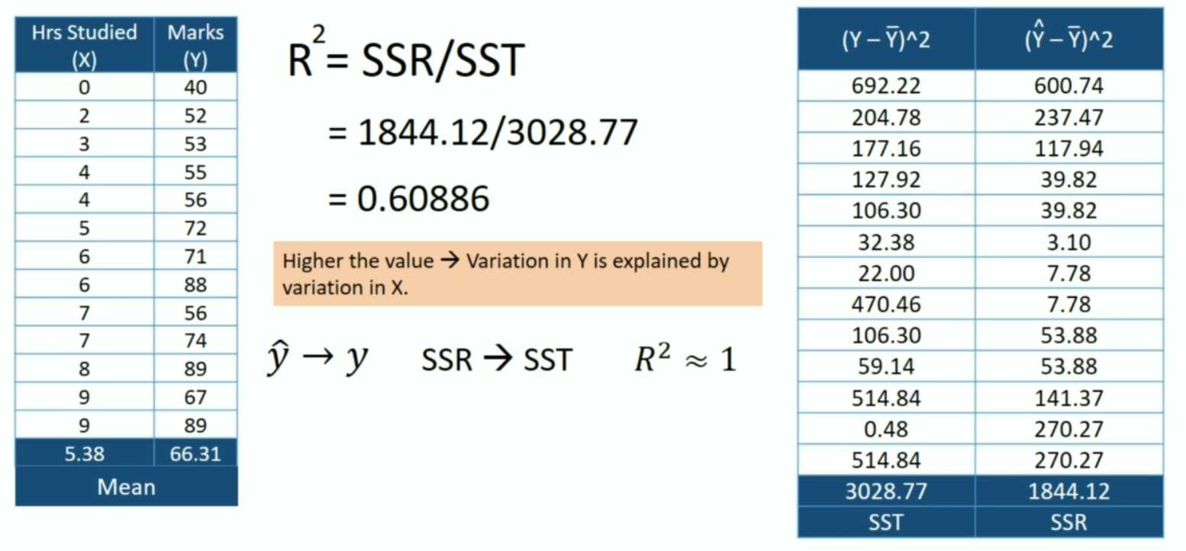
Evaluating Model Performance (R2)

Slide 31
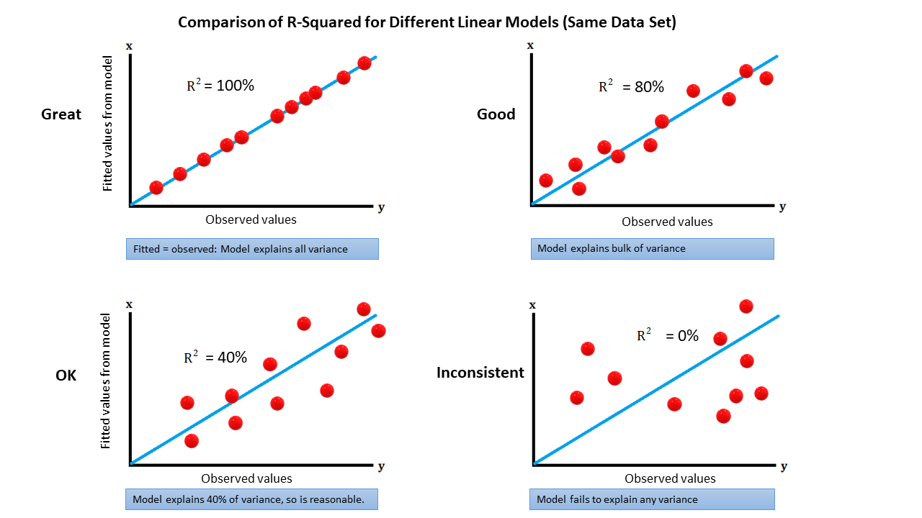
Evaluating Model Performance (R2)

Slide 32
Machine Learning
Supervised Learning
Regression
Simple Linear Regression
Multiple Linear Regression
Polynomial Regression
Evaluating Model Performance
Classification
Logistic Regression
K-Nearest Neighbors (KNN)
Naive Bayes
SVM
Decision Trees
Ensemble Methods
What is Bagging & Boosting
Random Forests
XGBoost
Evaluating Model Performance
Unsupervised Learning
Clustering
KMeans
Hierarchical Clustering
Density Based Clustering - DBSCAN
Association rule mining
Apriori
Dimension Reduction
PCA
LDA
Evaluating Model Performance
Model Selection & Evaluation
Cross Validation
Hyperparameter Tuning
Grid Search
Randomized Search
Recommendation Systems

Slide 33
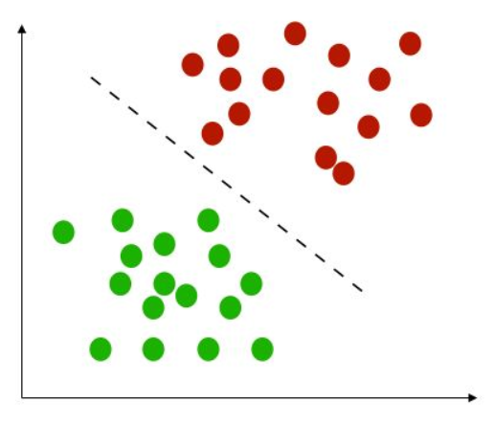
Classification
Classification specifies the class to which data elements belong to and is best used when the output has finite and discrete values. It predicts a class for an input variable as well.
For example,
it can be used to classify the animal in an image, it’s either a cat or a dog.
Email spam detection
Face classification
Patient has cancer or not
Fraud detection
…

Slide 34
Machine Learning
Supervised Learning
Regression
Simple Linear Regression
Multiple Linear Regression
Polynomial Regression
Evaluating Model Performance
Classification
Logistic Regression
K-Nearest Neighbors (KNN)
Naive Bayes
SVM
Decision Trees
Ensemble Methods
What is Bagging & Boosting
Random Forests
XGBoost
Evaluating Model Performance
Unsupervised Learning
Clustering
KMeans
Hierarchical Clustering
Density Based Clustering - DBSCAN
Association rule mining
Apriori
Dimension Reduction
PCA
LDA
Evaluating Model Performance
Model Selection & Evaluation
Cross Validation
Hyperparameter Tuning
Grid Search
Randomized Search
Recommendation Systems

Slide 35
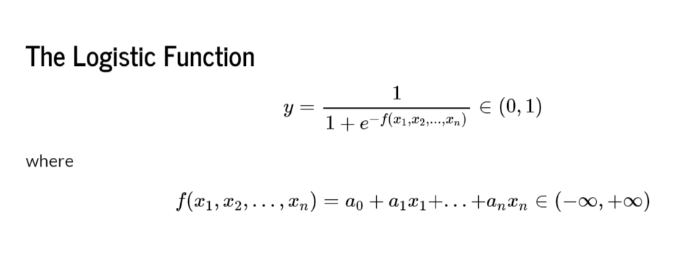
Logistic Regression

Slide 36
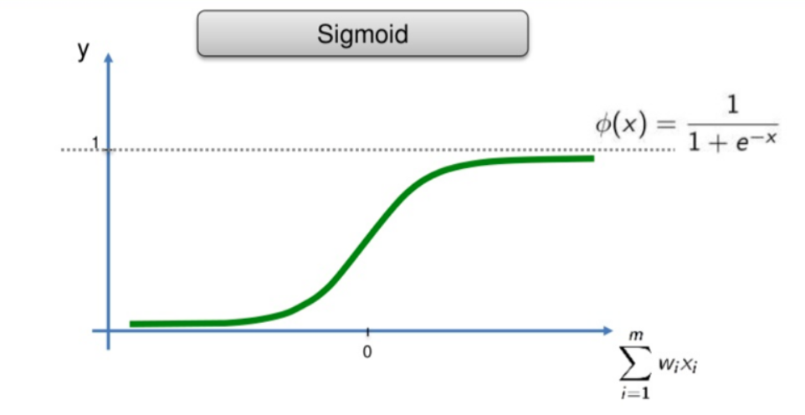
Logistic Regression

Slide 37
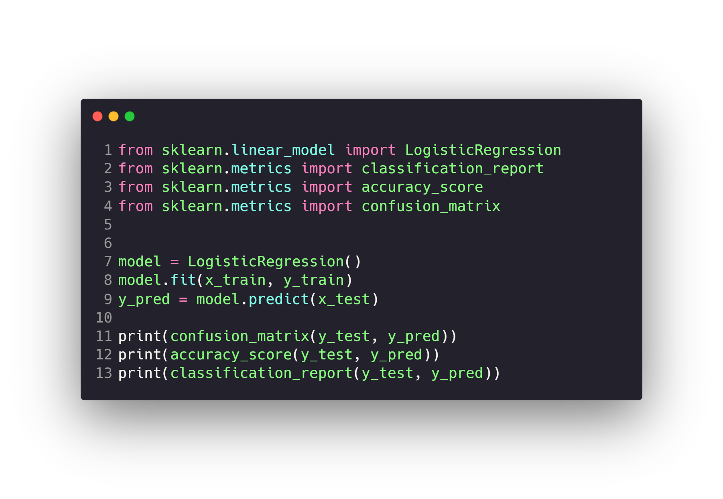
Logistic Regression

Slide 38
Machine Learning
Supervised Learning
Regression
Simple Linear Regression
Multiple Linear Regression
Polynomial Regression
Evaluating Model Performance
Classification
Logistic Regression
K-Nearest Neighbors (KNN)
Naive Bayes
SVM
Decision Trees
Ensemble Methods
What is Bagging & Boosting
Random Forests
XGBoost
Evaluating Model Performance
Unsupervised Learning
Clustering
KMeans
Hierarchical Clustering
Density Based Clustering - DBSCAN
Association rule mining
Apriori
Dimension Reduction
PCA
LDA
Evaluating Model Performance
Model Selection & Evaluation
Cross Validation
Hyperparameter Tuning
Grid Search
Randomized Search
Recommendation Systems

Slide 39
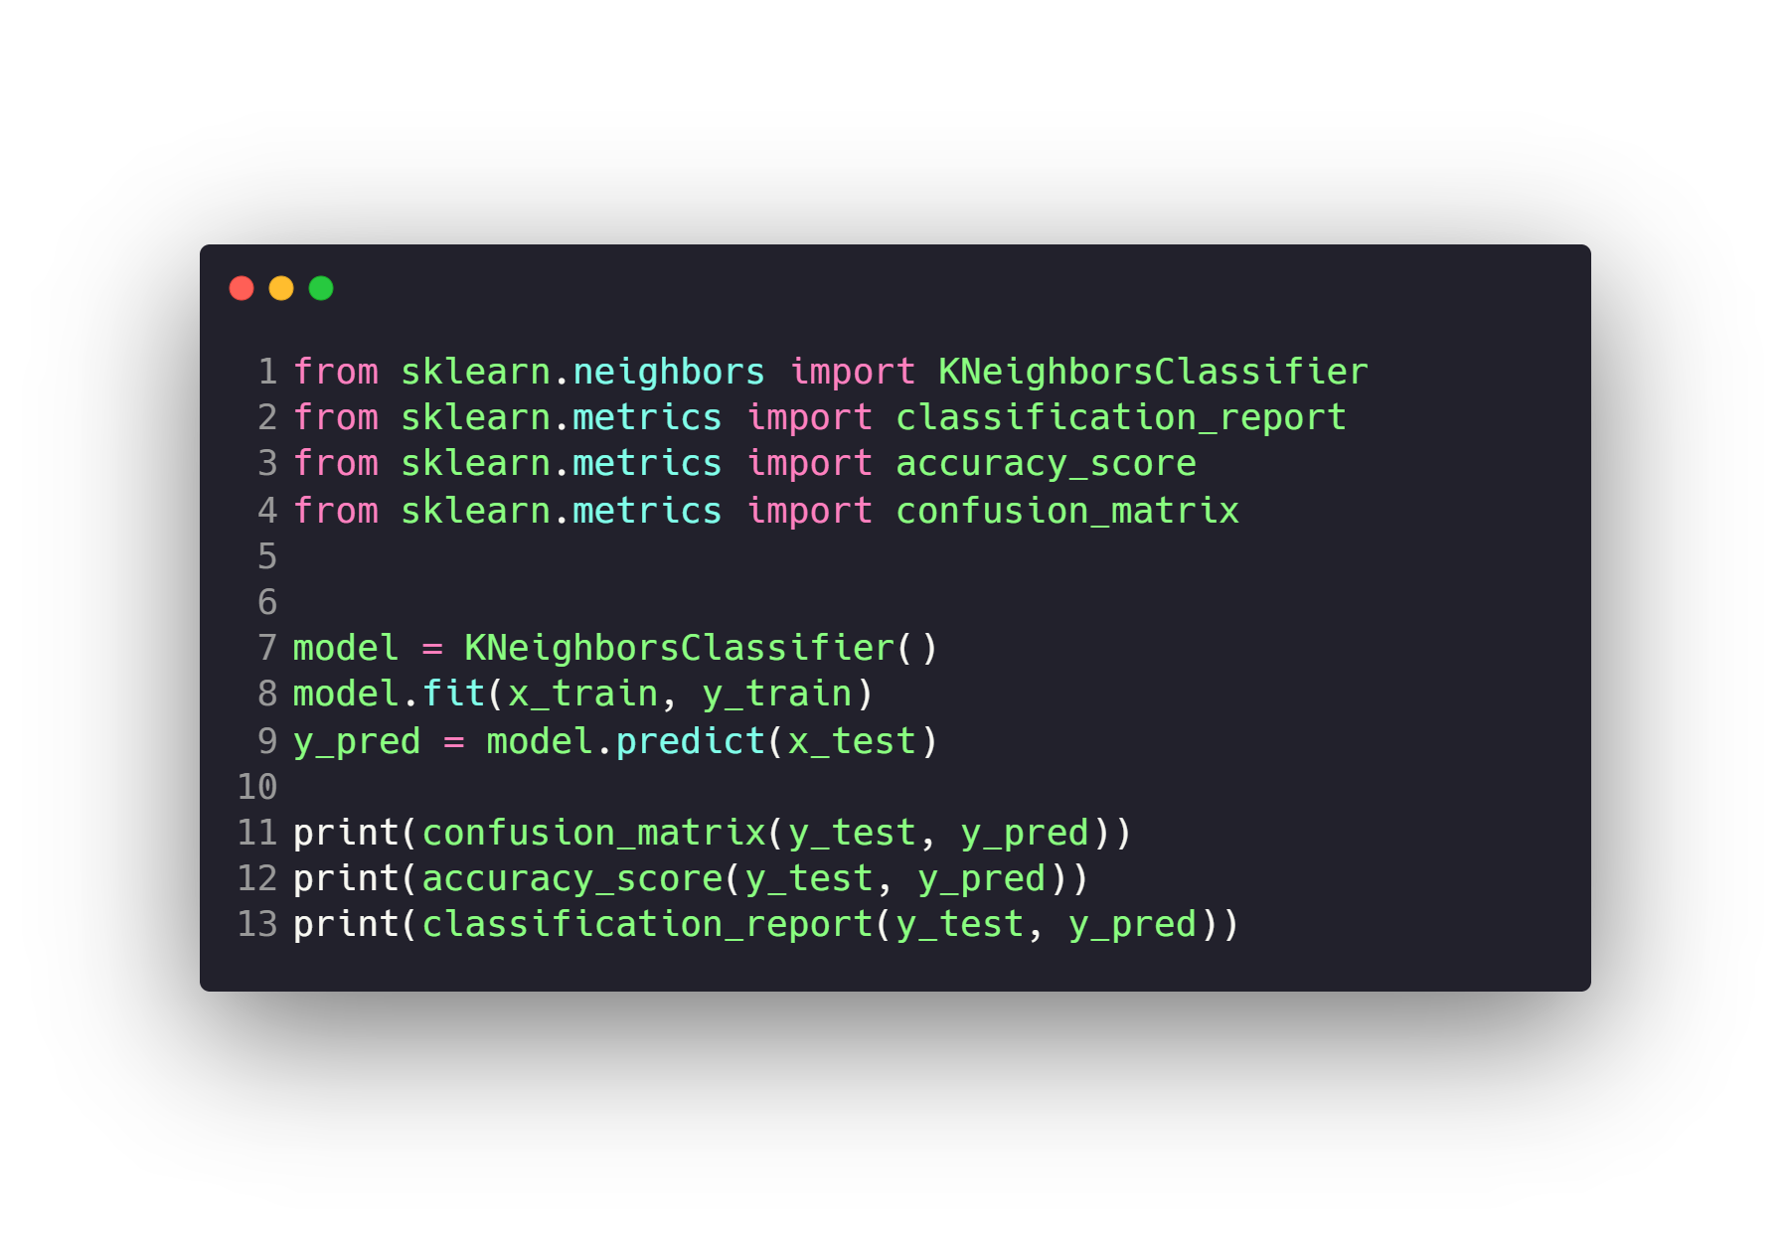
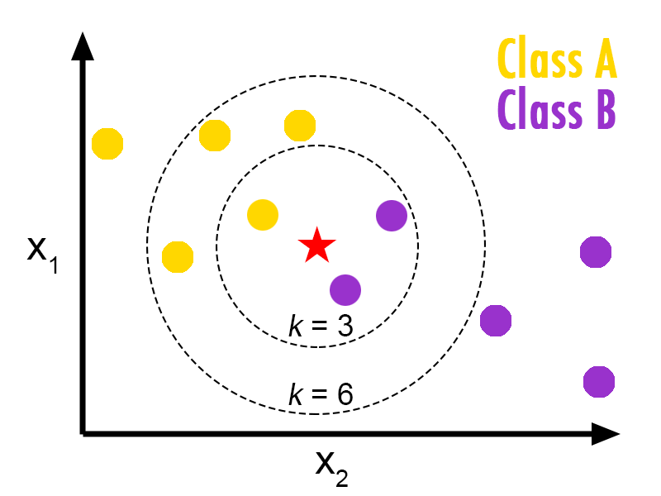
K-Nearest Neighbors (KNN)

Slide 40
Machine Learning
Supervised Learning
Regression
Simple Linear Regression
Multiple Linear Regression
Polynomial Regression
Evaluating Model Performance
Classification
Logistic Regression
K-Nearest Neighbors (KNN)
Naive Bayes
SVM
Decision Trees
Ensemble Methods
What is Bagging & Boosting
Random Forests
XGBoost
Evaluating Model Performance
Unsupervised Learning
Clustering
KMeans
Hierarchical Clustering
Density Based Clustering - DBSCAN
Association rule mining
Apriori
Dimension Reduction
PCA
LDA
Evaluating Model Performance
Model Selection & Evaluation
Cross Validation
Hyperparameter Tuning
Grid Search
Randomized Search
Recommendation Systems

Slide 41
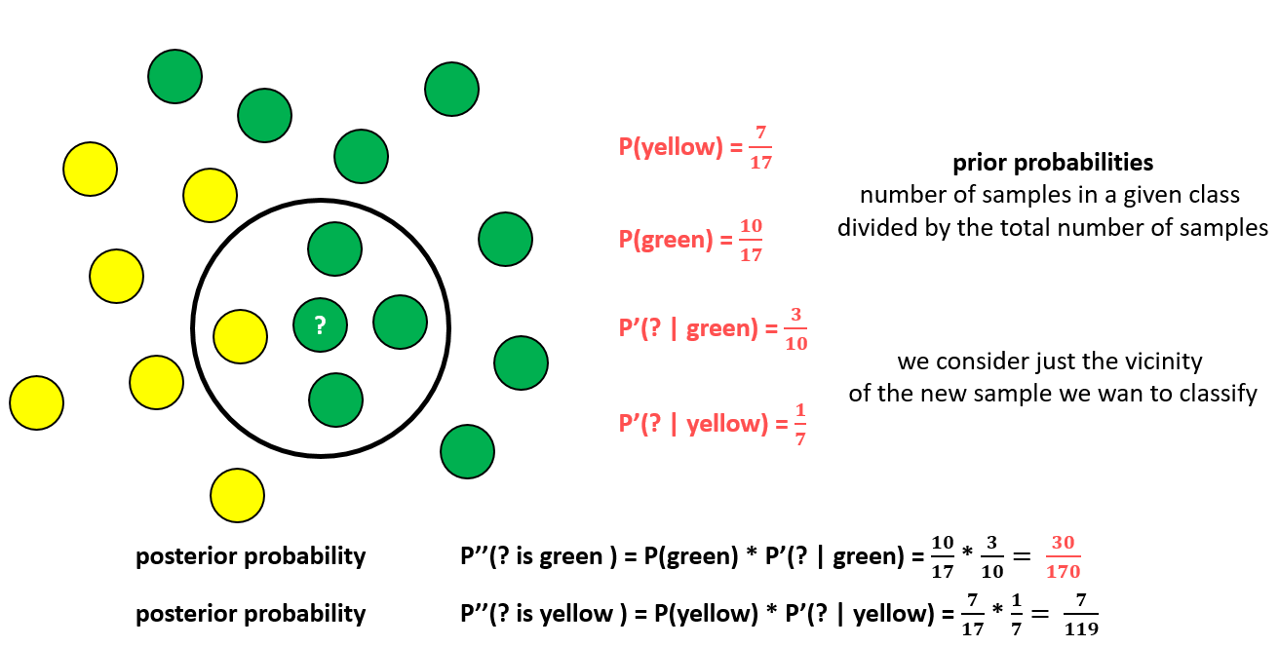
Naive Bayes

Slide 42
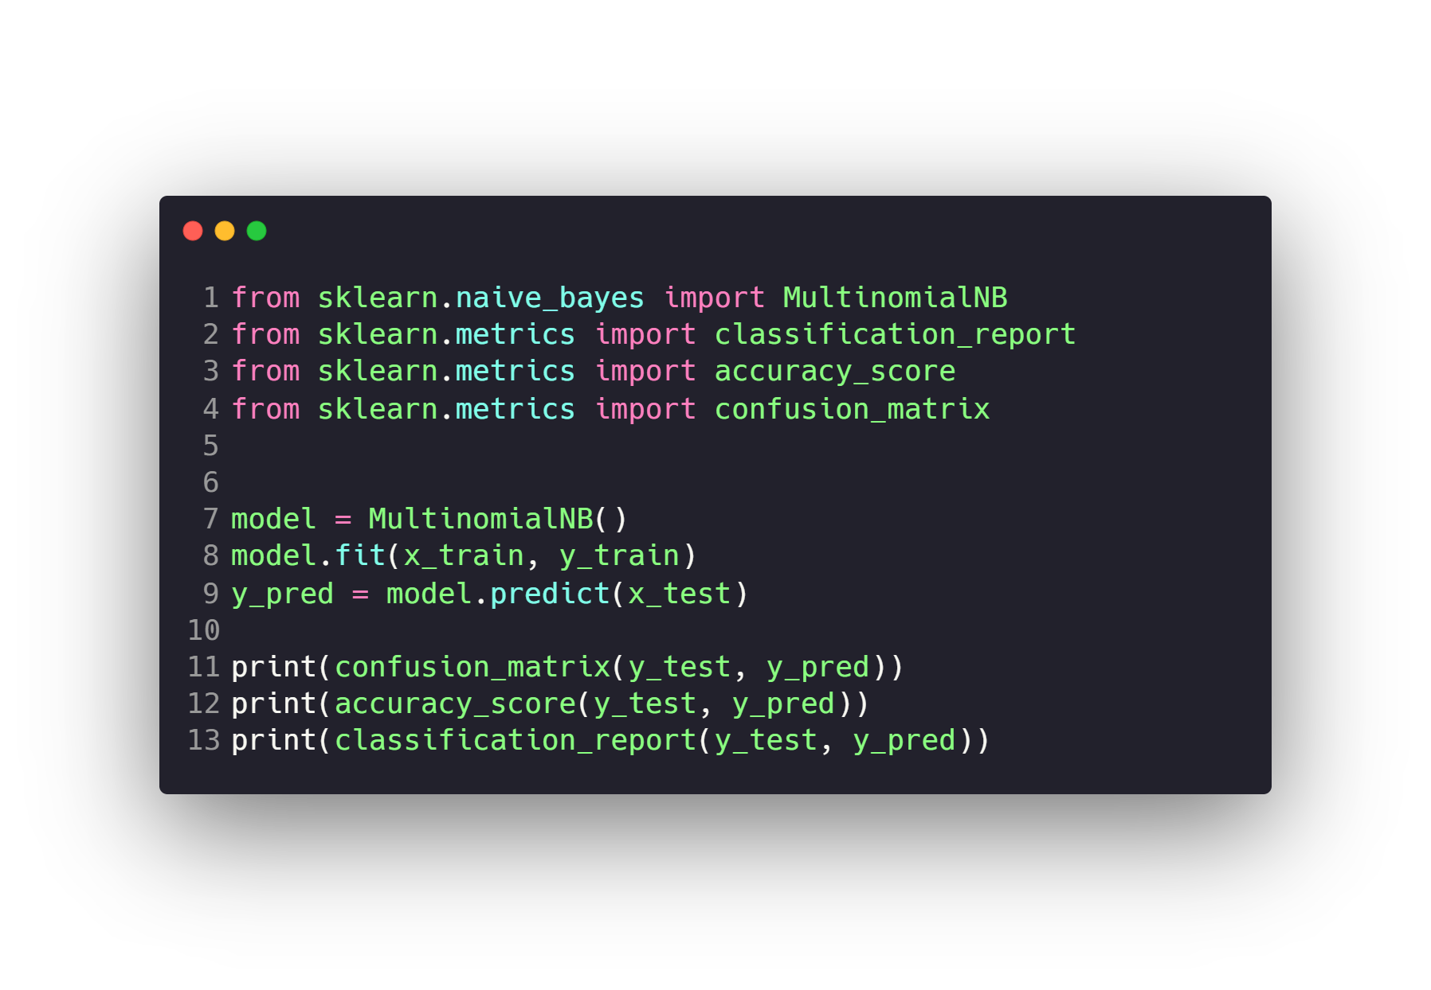
Naive Bayes

Slide 43
Questions ?!

Slide 44

Thanks! >_ Live long and prosper

